Slide 1

Retail Analysis
Ankit Kumar

Slide 2
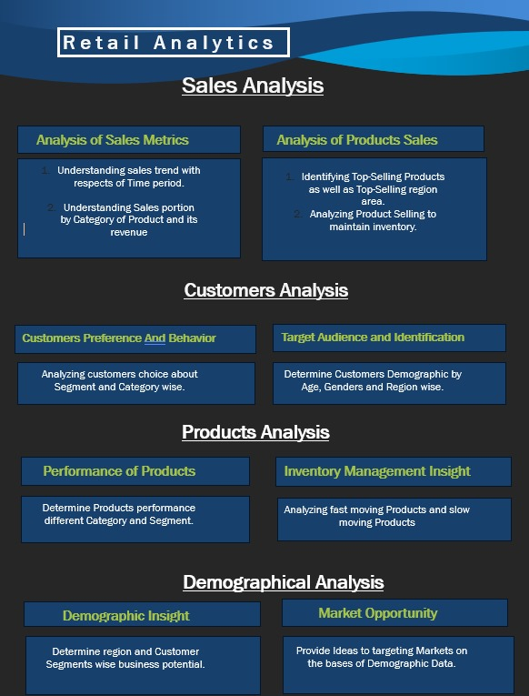

Slide 3
Overview
Objective : The objective of the project is to create a comprehensive Power BI dashboard utilizing the sample retail analysis database. The dashboard aims to provide valuable insights for sales, product, customer and demographic analysis. It enables the data-driven decision, optimize sales strategies and enhance customer experiences.
Analysis Scope : The Analysis will focus on various aspects that utilize data from offices, employees, customers, products, orders and payments tables. Analysis scope focus on sales performance, customer behavior, product analysis and demographic insights.
Goal : The primary goal of this Power BI dashboard is to provide stakeholders with actionable insights and optimize sales strategies and inventory management. It enhance targeted marketing and customer experiences.

Slide 4
Overview
Insights & Recommendations : The Power BI dashboard will generate valuable insights for Sales Analysis by top selling products and their performance and optimize pricing strategies based on product performance. For customer analysis gives insight for customer segmentation based on buying behavior and personalized marketing strategies based on customer segments. For Product Analysis it gives insight for product line performance and popularity, inventory level and stock movement, that highlights underperforming products for marketing.
Report and Presentation : The final deliverable will consist of a detailed report describing the data source, data modeling methodologies and data cleaning process used in creating power BI dashboard. The report will also include a step-by-step guide on how to interpret the insights and use the dash board for decision making. The presentation will show case the key findings, visualization and actionable recommendations derived from the dashboard analysis.

Slide 5
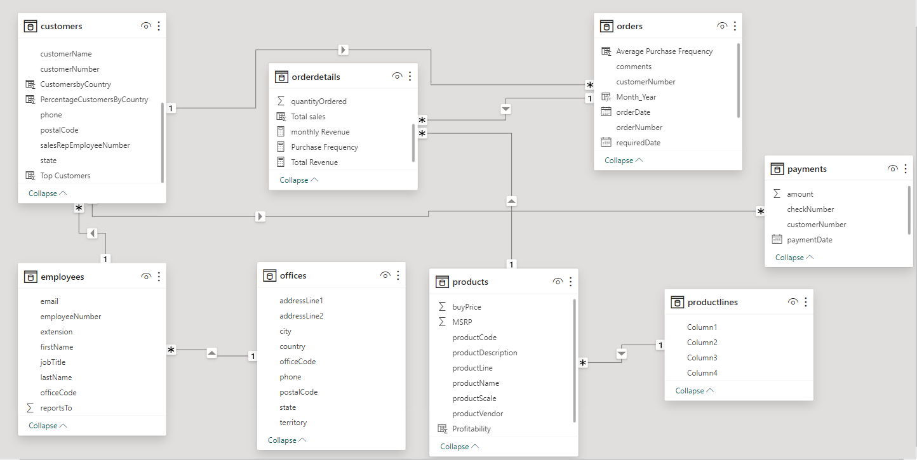
ER Diagram

Slide 6

Power Bi
Problem Statement

Slide 7
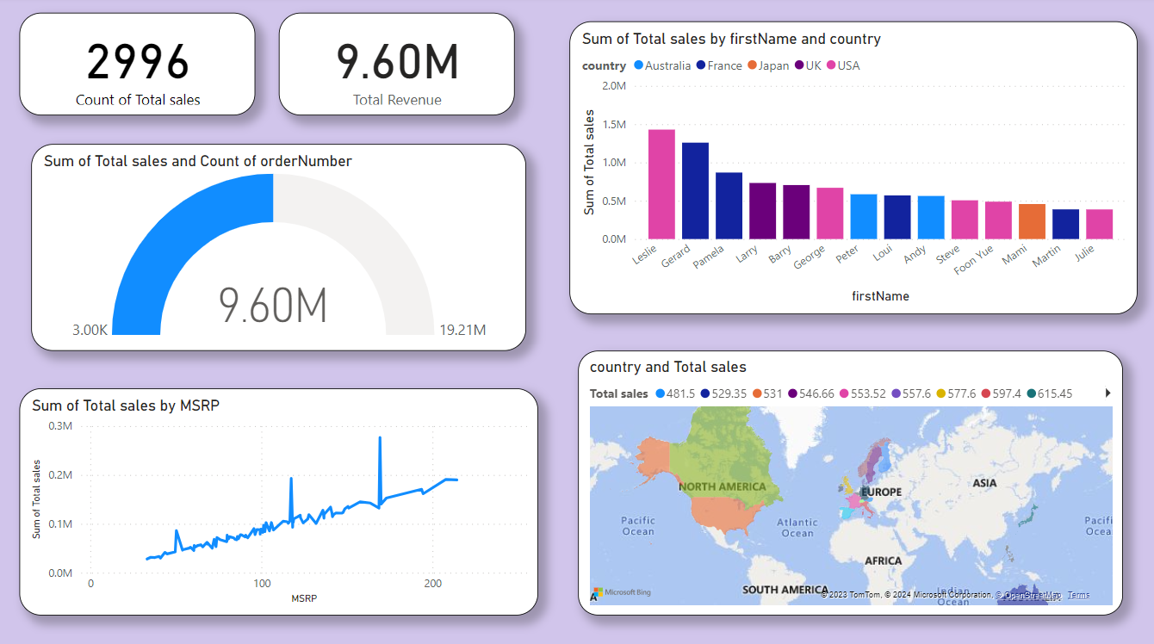
Sales Analysis

Slide 8
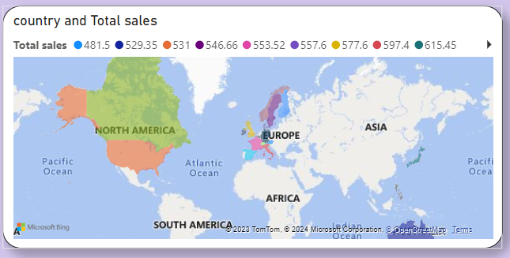
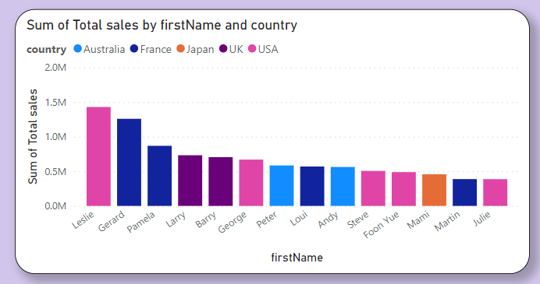
What are the top regions in terms of sales revenue? (Visual: Sales revenue by region) Present insights derived from the analysis, such as:
Top regions contributing to sales revenue. Trends or patterns observed in different regions. Factors influencing higher sales in specific regions

Slide 9
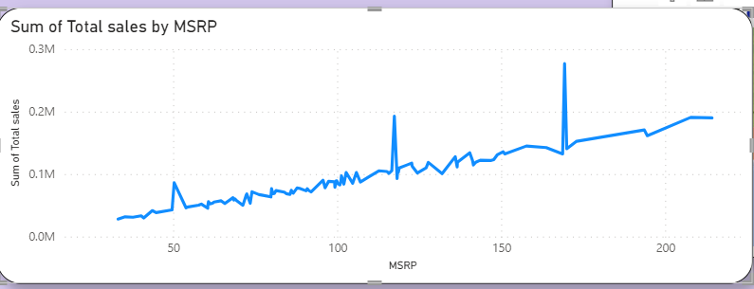
How does product pricing impact sales volume? (Visual: Product price vs. sales volume) Factors influencing pricing decisions (costs, competition, perceived value, etc.). Impact of pricing strategies on sales and market positioning.

Slide 10
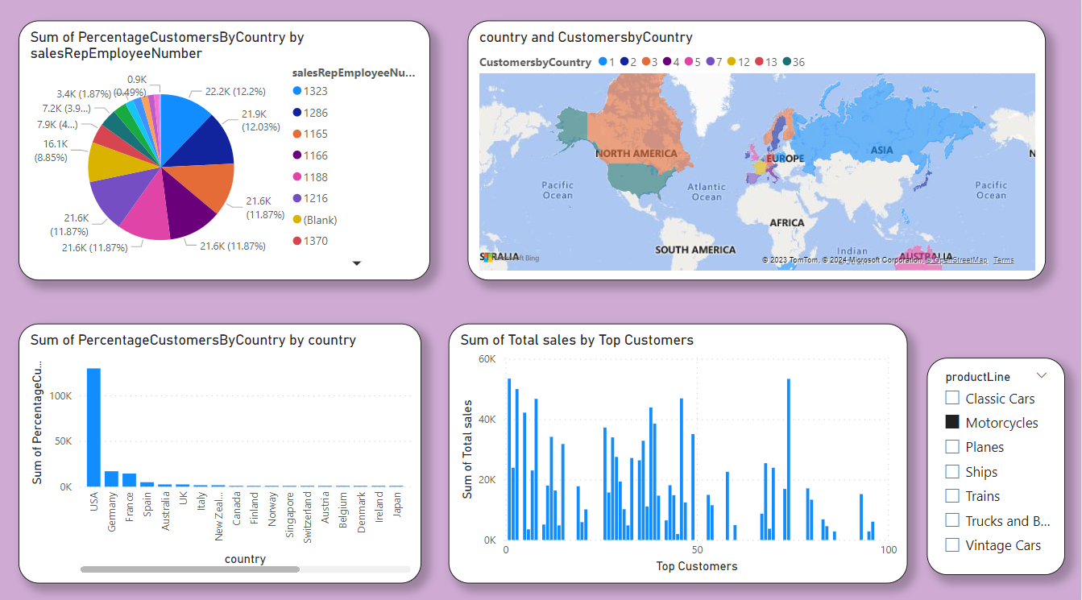
Customer Analysis

Slide 11
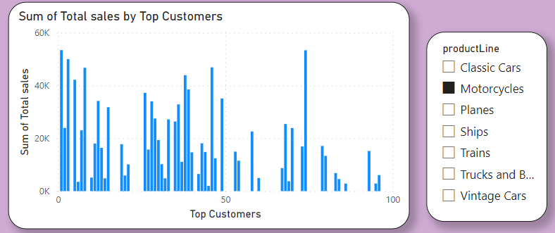
How does the sales performance of top customers compare to the rest? (Visual: Sales contribution by top customers vs. others) Utilize Power BI visuals to present trends over time for top customers versus others.
Consider using slicers or filters to allow interactive analysis of sales performance by customer segments, regions, or products.

Slide 12
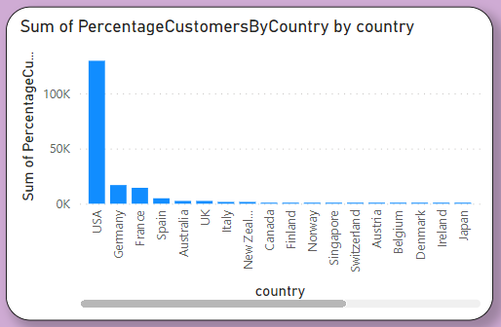
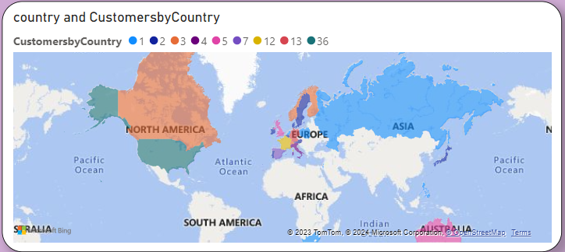
What is the distribution of customers across different demographic segments? (Visual: Customer segmentation by demographics) Identify the most significant demographic segments (e.g., which country has the highest number of customers).
Analyze patterns or anomalies (e.g., unexpected concentration of customers in a specific city or region).

Slide 13
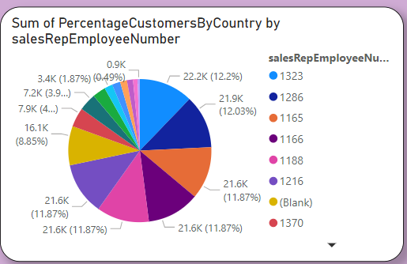
How does the performance of sales employees vary across different regions? (Visual: Employee performance by region). Identify Top Performers:
Highlight top-performing sales employees across regions based on sales volume, conversion rates, or other relevant metrics.

Slide 14
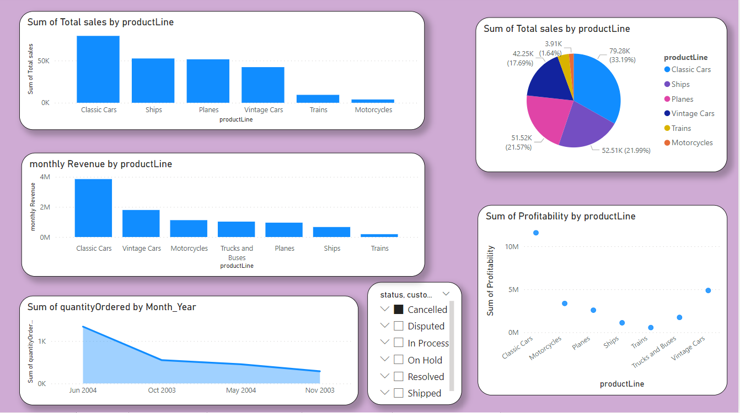
Product Analysis

Slide 15
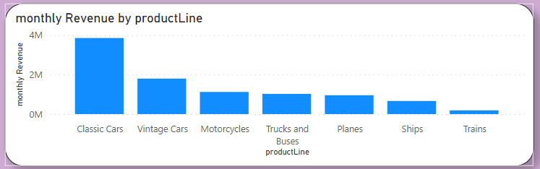
How does monthly revenue vary across different product categories? (Visual: Monthly revenue by product category) Observe the fluctuation in revenue across months for different product categories.
Identify peak months or seasonal trends for specific product categories. Compare the performance of various product lines over time. Highlight any significant changes or anomalies in revenue for Particular category.

Slide 16
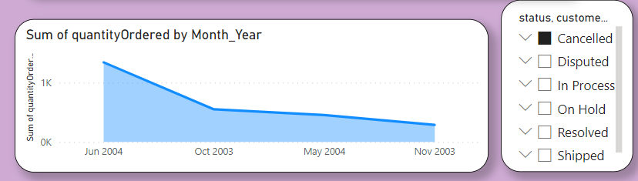
What is the trend in customer order volume over the past year? (Visual: Monthly order volume trend) There is a general upward trend in the number of orders placed over the year. This could be due to a number of factors, such as increased marketing, product expansion, or simply a growing customer base.
There are a few spikes in the data that don't appear to be related to seasonality. For example, there is a spike in orders in October 2003 and another in March 2004. These spikes could be due to promotions, product launches, or other events

Slide 17
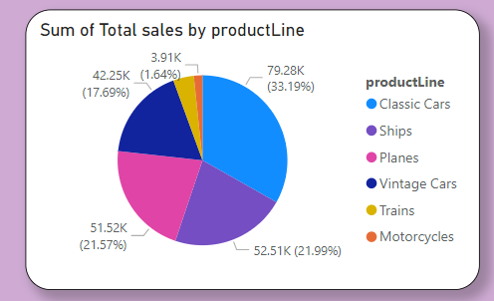
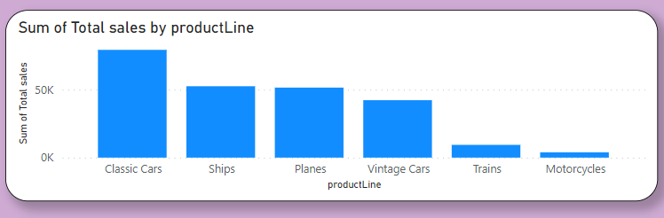
What is the distribution of product sales across different product lines? (Visual: Product sales by product line) The data appears to be for a single company. This is because the graph only shows sales data for four product lines. It is likely that a company would only sell a limited number of product lines.
The data does not include sales for all products. This is because the graph only shows sales data for four product lines. It is possible that the company also sells other products, such as boats or buses.

Slide 18
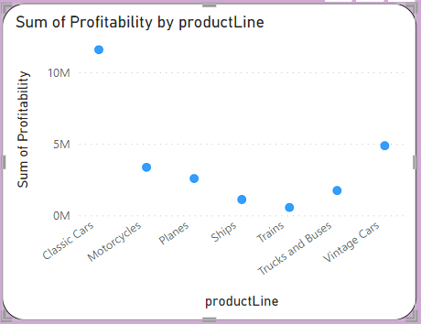
How does the profitability of different products compare based on their quantity in stock? (Visual: Profitability vs. quantity in stock) Classic cars are the most profitable product line, followed by planes. This is likely due to the high cost of these vehicles and the limited number of them available on the market. There is a significant gap between the profitability of classic cars and planes and the profitability of the other product lines.

Slide 19
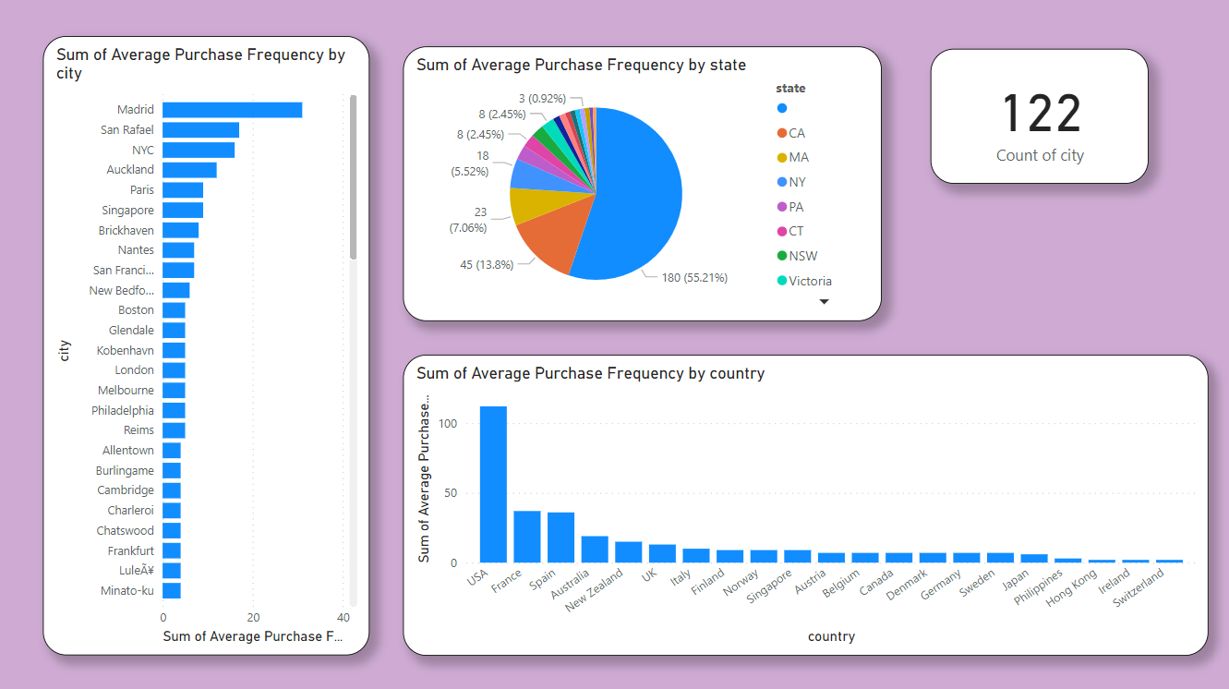
Demographic Analysis

Slide 20
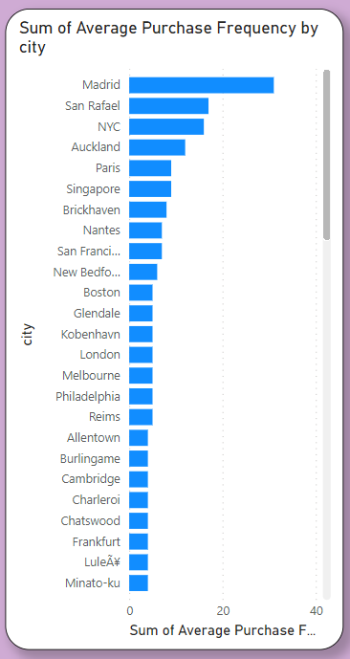
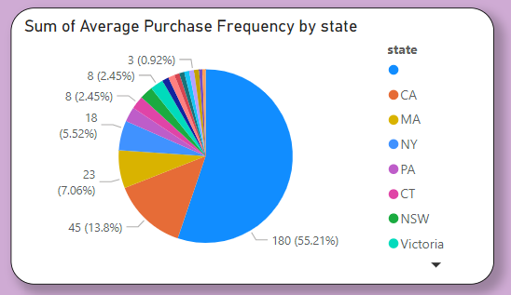
What is the correlation between customer demographics and purchase frequency? (Visual: Customer demographics vs. purchase frequency) City purchase frequency varies greatly by location. Paris, New York City, and Boston lead with over 8 purchases per month on average. Meanwhile, cities like Allentown and Charleroi average under 3 purchases per month.
US and European cities dominate the top 10. This could be due to factors like higher disposable income, larger populations, or more developed e-commerce infrastructure.
Australia and New Zealand also have a strong showing. Melbourne and Auckland both rank in the top 10, suggesting these developed Pacific Rim cities have active consumer bases.

Slide 21

EDA Problem
Statements

Slide 22
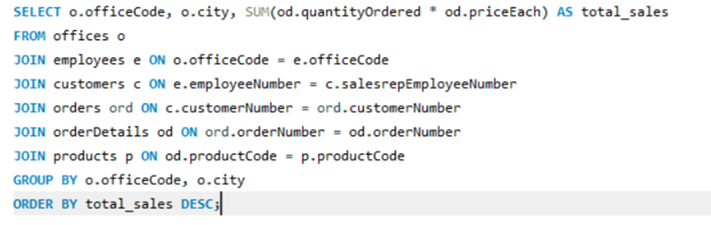
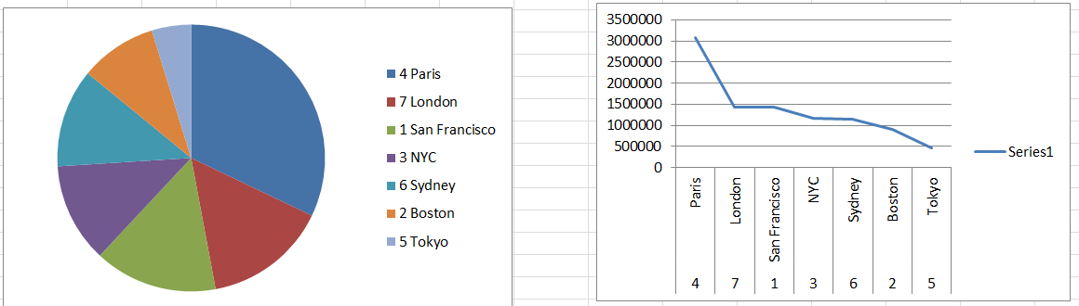
Which factors contribute to the highest sales in a particular region? Conclusion:
The data visualization shows the | shows that
Paris has the highest total sales, followed by
London, San Francisco, NYC, Sydney, Boston and Tokyo.

Slide 23
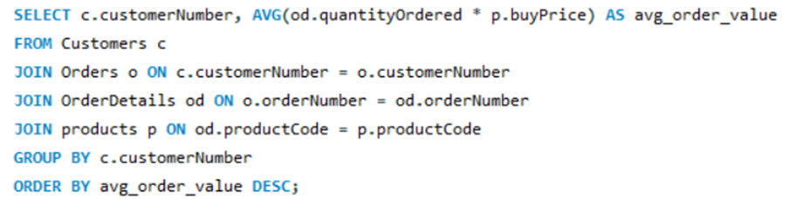
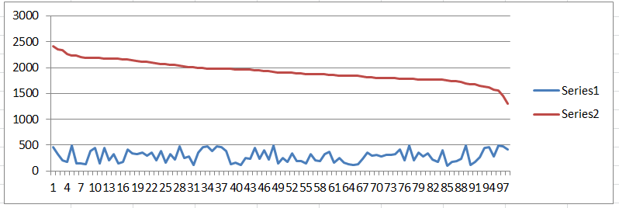
How can customer purchasing patterns be influenced to increase average order value?
Conclusion :
It gives the comparison the average order values across
different customers, helping you identify high value customers or trends in purchasing behavior.

Slide 24
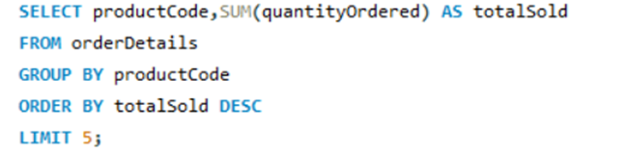
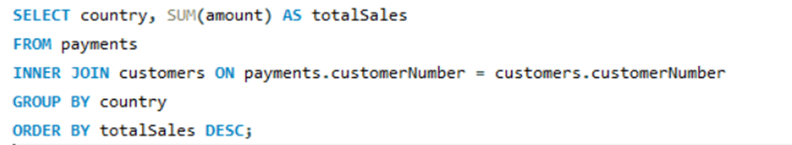
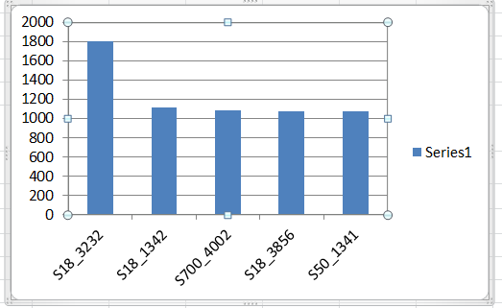
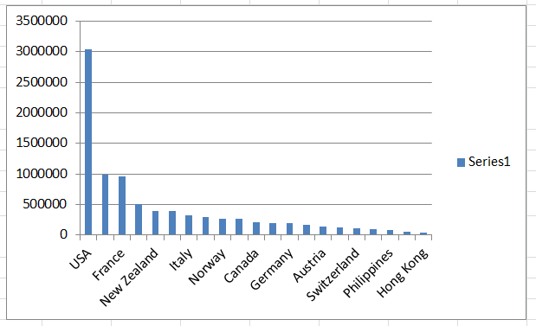
What are the key drivers of sales growth, and how can they be leveraged for future success?
 | This insight provides a comprensive view of analyzing top selling products
 | how business can leverage this information for various strategic decisions.
The distribution of sales across countries highlights regions where the company has a substantial customer base or a strong market presence.

Slide 25
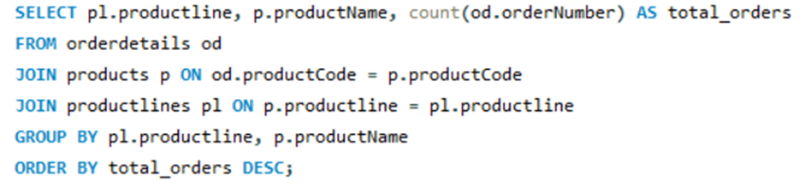
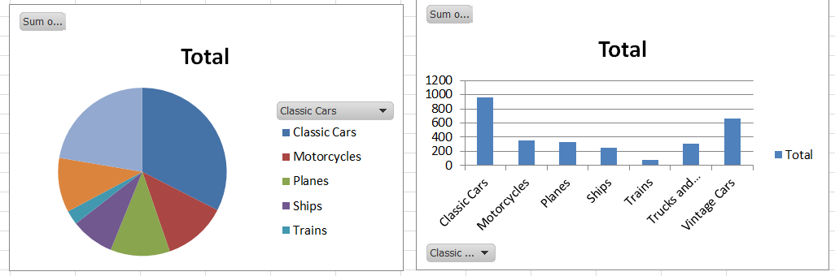
Which product features or attributes are most appealing to customers?
These insights can aid in making informed business decisions, marketting strategies, or inventory management based
on the popularity and representation of different product categories.

Slide 26
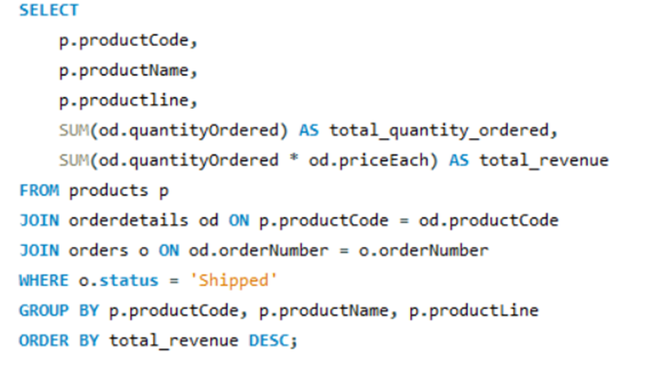
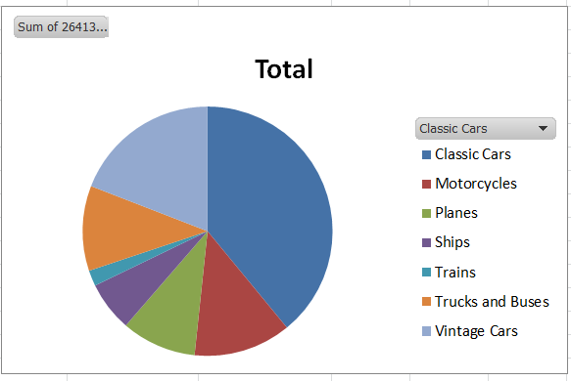
How can the product mix be optimized to cater to changing market demands?
This pie chart show the revenue by product line which involves analysing the sales data, understanding customer preferences, adjusting the product offerings.

Slide 27
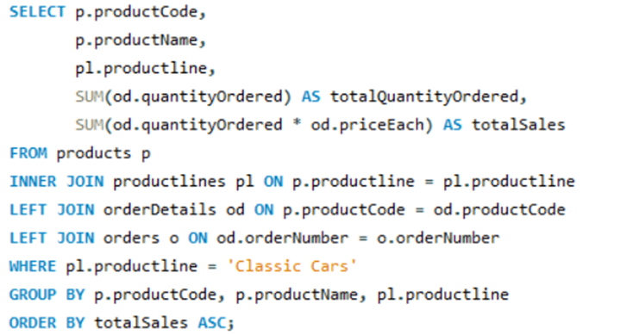
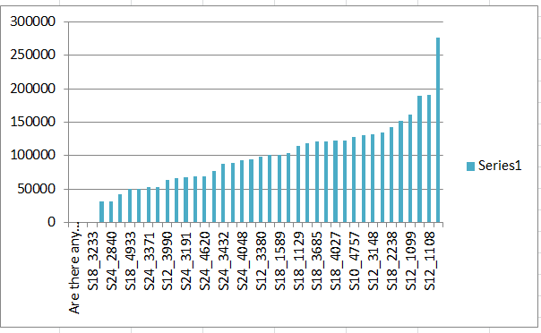
Are there any specific market segments where a particular product is underperforming, and how can it be improved?
Bar chart showcasing the total sales for each product in
the classic cars line. This will identify the best selling products.

Slide 28
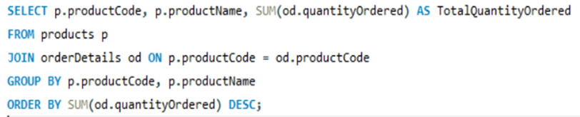
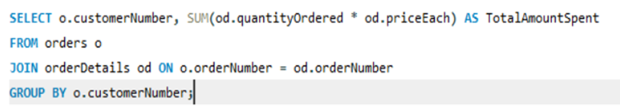
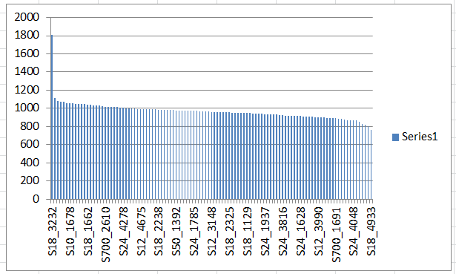
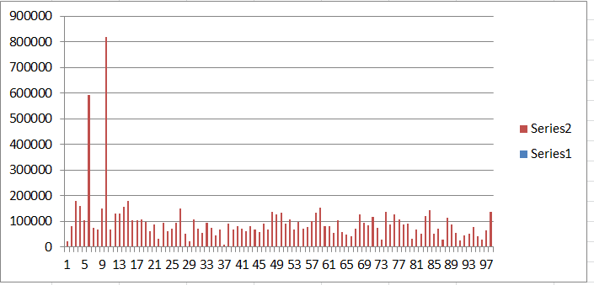
What are the main factors that influence customer loyalty and repeat purchases?
This chart shows the customers who have spent the total amount of money
to show the value and loyalty.
This chart shows the most purchased products by the customers and indicating the chart with customer number.

Slide 29
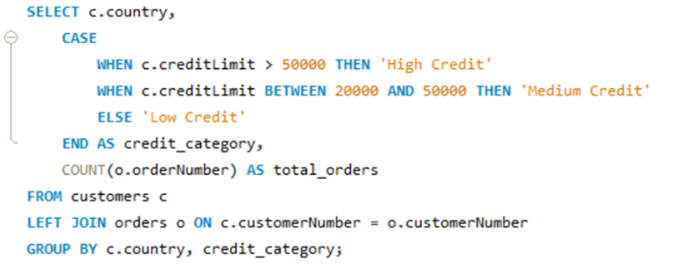
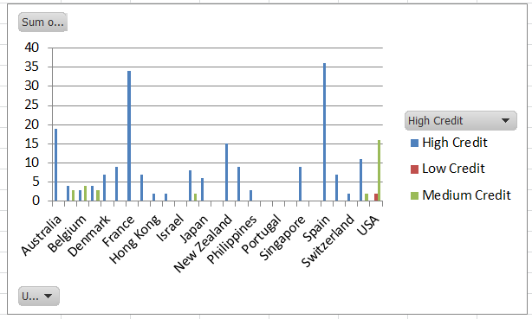
How do customer preferences differ based on geographic location, and how can marketing campaigns be customized accordingly?
They aim to provide insight into customer behaviour, preferences and purchasing patterns across different geographic
locations, which can be valuable for tailoring marketing strategies.

Slide 30
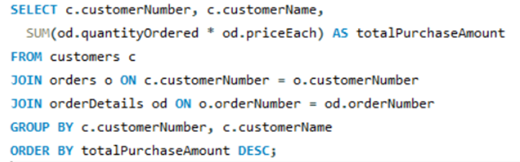
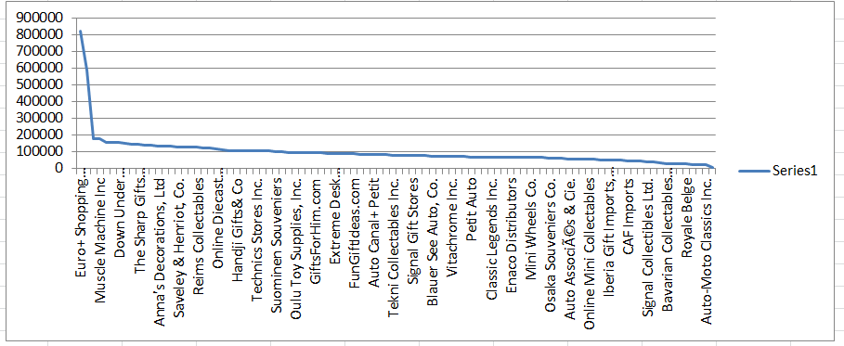
What are the characteristics of high-value customers, and how can similar customers be targeted for acquisition?
The Visualization will show a comparison of total purchases
amout for different customers.
This insight can help focus on high value customers for targeted
marketing or customer relationship management strategies.

Slide 31
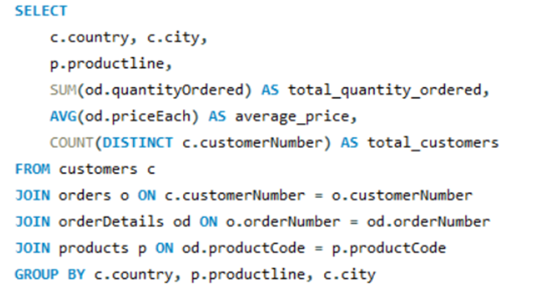
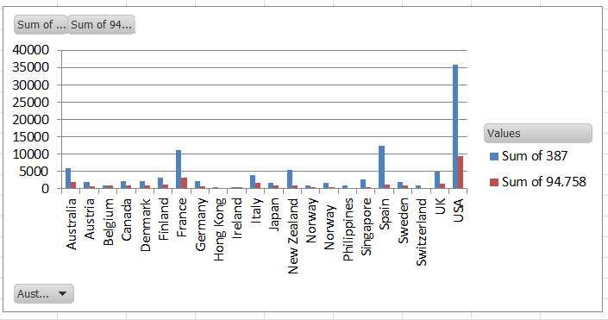
How can marketing strategies be tailored to target specific demographic segments in different regions?
The Insight gives the total quantity ordered, average price, customer count for each product line in different cities across various countries.

Slide 32
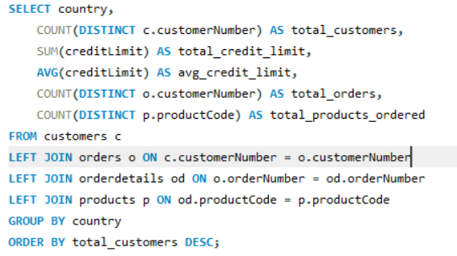
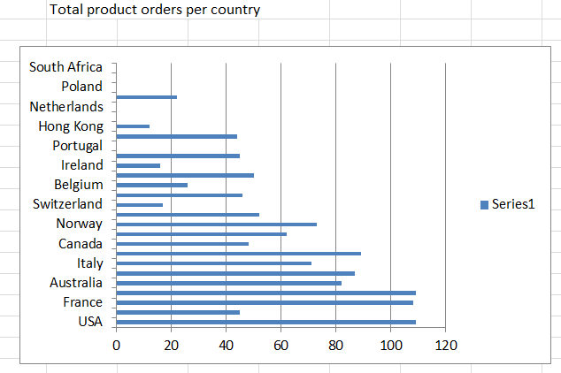
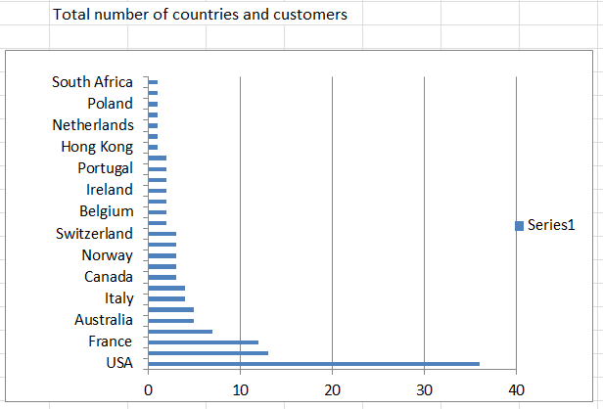
What are the potential untapped markets based on demographic indicators, and how can market penetration be increased?
The USA has the highest total credit limit, total orders, total product
orders and highest number of distinct customers, indicating
a substantial market presence.

Slide 33
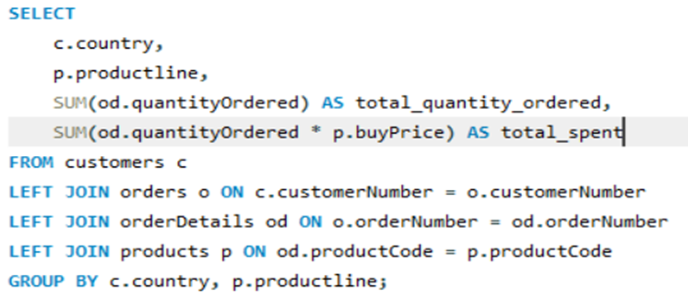
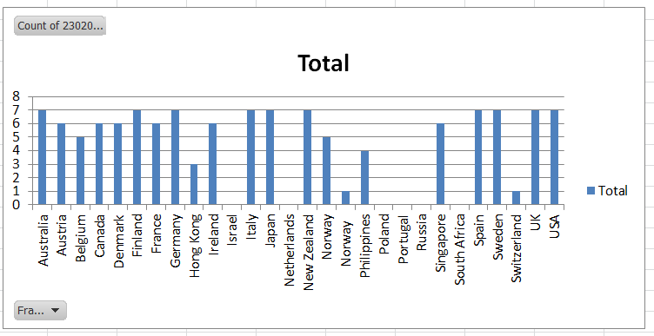
How do customer preferences and behavior differ based on demographic factors, and how can they be leveraged for personalized marketing campaigns?
By Visualizing the data in Excel, you can gain valuable insights into product line preferences,
expenditure patterns and potential market oppourtinities in different countries.

